Slide 1
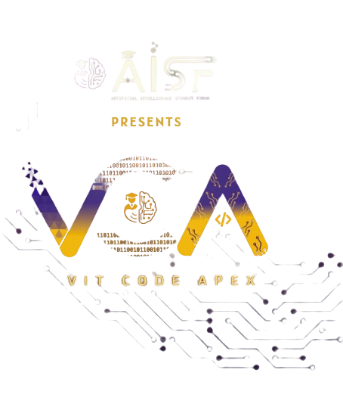

Slide 2

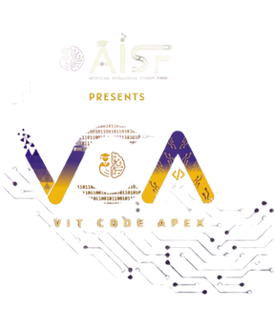
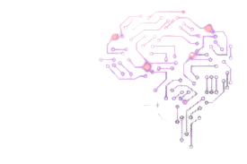
CODE VERSE HACKATHON 2025
Problem Statement Title-
Team Name-TrailBlazers
Team Members-
AI Powered Solution for Marine Fouling Detection & Classification
Aryan Kulkarni,
Mihir Kulkarni,
Swaroop Lenka,
Harsh Makde

Slide 3
Intelligent Marine Fouling Management
Our Solution: An AI-Powered Intelligent Image-Based System
1
2
3
Automated Detection
Our system automatically detects various fouling species(algae, barnacles, mussels, microorganisms) on ship hulls.
Density Classification
It classifies fouling density into Low, Medium, and High levels, providing critical data for maintenance planning.
Real-Time Insights
A visual dashboard provides the Indian Navy with immediate insights to plan maintenance, optimize fuel, and ensure operational readiness.
Innovation & Uniqueness
Dual Classification: The first system to classify both species and density simultaneously.
Automated Inspection: Replaces slow and costly manual diver inspections.
Adaptable Solution: Extendable to offshore platforms, submarines, and underwater sensors.

Slide 4





TECHNICAL APPROACH
Programming : Python, OpenCV: Core programming and image processing.
Visualization & Report : Matplotlib / Seaborn: Tools for precise data labeling to ensure model accuracy.
Our Tech Stack
Deep Learning Frameworks : PyTorch, TensorFlow: Training and deploying advanced AI models.
AI Models : YOLOv8, Faster R-CNN, ResNet, EfficientNet: State-of-the-art for detection and classification.
Deployment : Streamlit, Flask to secure on-premise Navy servers, option for private cloud deployment

Slide 5
TECHNICAL FLOW
Image Input
Preprocessing(Noise removal , Color correction)
Detection(YOLO / Faster R-CNN)
Report(Maintenace Insights)
Density Estimation(% Coverage)
Classification(CNN Models)

Slide 6
FEASIBILITY AND VIABILITY
Our AI-powered solution isn't just innovative—it's practical, achievable, and poised for real-world impact.
Technical Feasibility
AI-based detection is a proven concept, adaptable from medical imaging and underwater robotics.
Moderate dataset size, achievable through augmentation and synthetic data, makes training efficient.
Economic Feasibility
Long-term fuel cost savings of 30-40% annually significantly outweigh initial development costs.
Leverages readily available, open-source technologies (Python, PyTorch, OpenCV, YOLO).
Operational Feasibility
Deployable on existing Navy ships with camera inspection systems.
Seamless integration with underwater drones (ROVs) for data capture.
Why It's Viable
Scalable from prototype to full deployment with limited datasets.
Aligns with the Navy’s strategic push for indigenization and AI adoption.

Slide 7
IMPACT AND BENEFITS
This solution offers far-reaching advantages for the Indian Navy, the nation, and the environment.
Strategic Edge
Ships maintain optimal performance, enhancing combat readiness and mission effectiveness.
Economic Savings
Fuel consumption reduced by 30-40% annually, leading to substantial operational cost savings.
Digital Transformation
Transitions the Navy from manual, labor-intensive inspections to AI-driven automation.
Environmental Stewardship
Minimizes the spread of invasive species, contributing to global marine ecosystem health.
“This solution is not just about detecting fouling—it’s about giving the Indian Navy a strategic, economic, and environmental advantage, powered by indigenous AI innovation.”

Slide 8
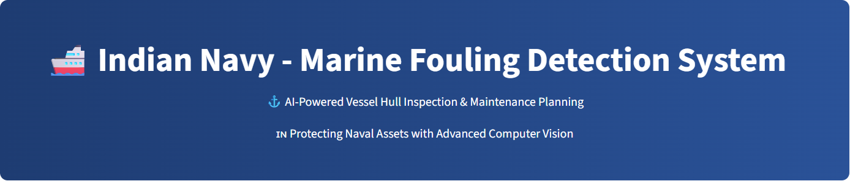
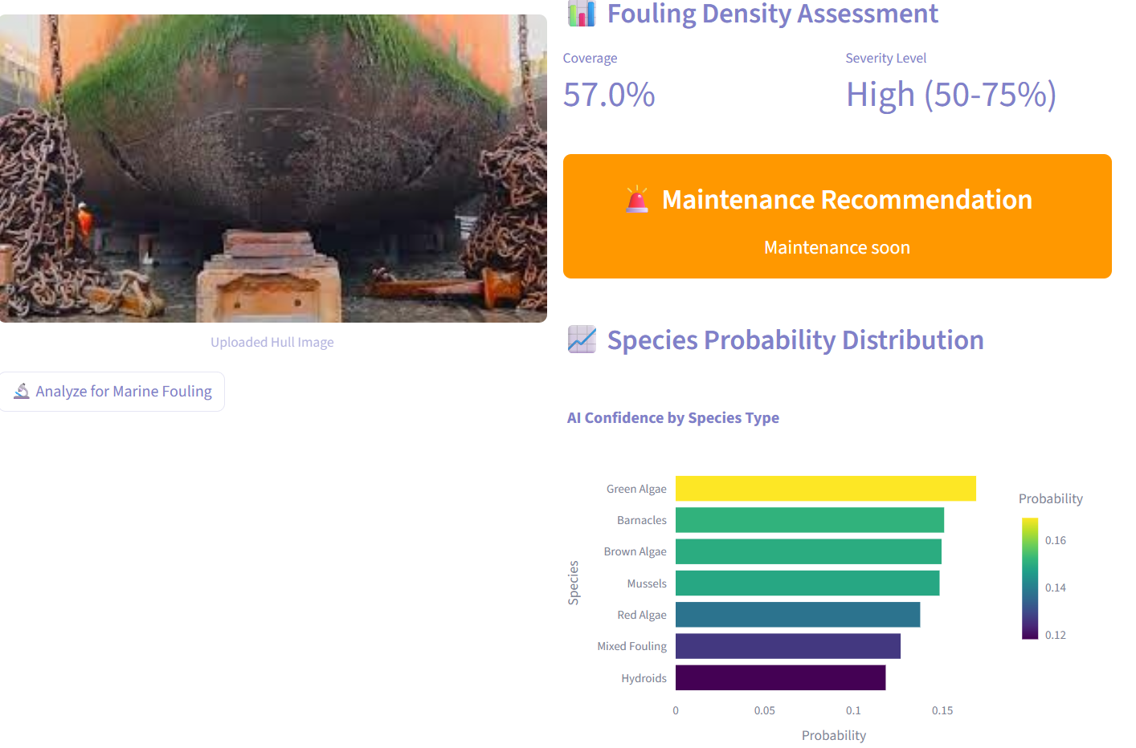
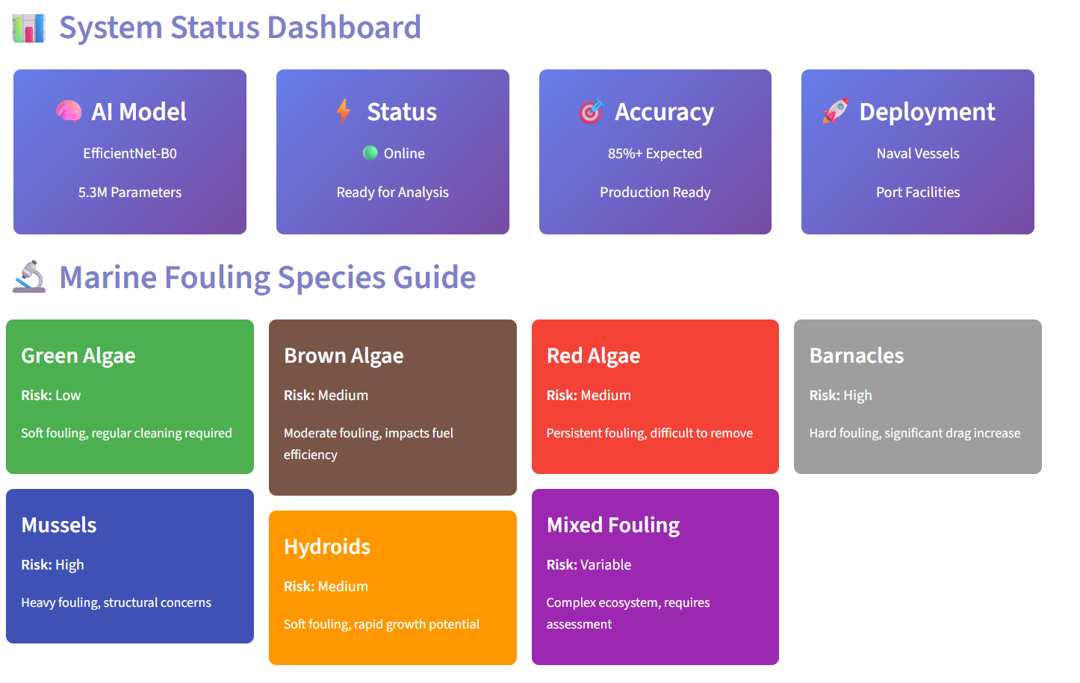
PROTOTYPE

